Slide 1



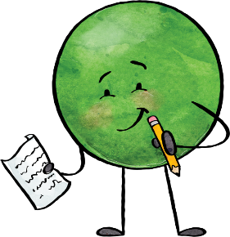


Grades 1 to 2
5 to 10 minutes Religion
20 to 25 minutes daily Reading | Science/Social/Health connections (as appropriate)
20 to 25 minutes three times a week Writing | Science/Social/Health connections (as appropriate)
20 to 25 minutes daily Math
20 to 25 minutes three times a week Flex | Phys. Ed. Arts Ed.
3 + 3 =

Slide 2
Grades 3 to 5
5 to 10 minutes Religion
25 to 30 minutes daily Reading | Science/Social/Health connections (as appropriate)
25 to 30 minutes three times a week Writing | Science/Social/Health connections (as appropriate)
25 to 30 minutes daily Math
25 to 30 minutes three times a week Flex | Phys. Ed. Arts Ed.
3 + 3 =

Slide 3
Grades 6 to 8
5 to 10 minutes Religion
30 to 45 minutes daily Reading | Science/Social/Health connections (as appropriate)
30 to 45 minutes three times a week Writing | Science/Social/Health connections (as appropriate)
30 to 45 minutes daily Math
30 to 45 minutes three times a week Flex | Phys. Ed. Arts Ed.

Slide 4
Grade: |  | Resources
Religion
Math
Literacy Science/Social/ Health connections (as appropriate)
Flex | Phys. Ed.
 | Arts. Ed.
 | Social /Emotional Development
 | Indigenous Education
 | Other

